Slide 1
How did we end up with four gospels?

Slide 2
How did we end up with four gospels?
Don’t need to take notes.
Notes:
I have all this content captured in an PDF essay that you can download.

Slide 3
How did we end up with four gospels?
Matthew
Mark
Luke
John

Slide 4
How did we end up with four gospels?
Matthew
Mark
Luke
“Synoptic Gospels”
John
Notes:
The first three of these are called “Synoptic Gospels”.

Slide 5
How did we end up with four gospels?
Matthew
Mark
Luke
“Synoptic Gospels”
John
Notes:
“Synoptic” means “to give an account of events from THE SAME POINT OF VIEW.”

Slide 6
How did we end up with four gospels?
Matthew
Mark
Luke
“Synoptic Gospels”
Explaining similarities & differences:
“The Synoptic Problem”
John
Notes:
There are many similarities between MM&L. There are also some pretty distinct differences between them.
The question of how to explain the similarities and differences between them is called “the synoptic problem”

Slide 7
The Q Hypothesis
Notes:
The most common solution to the Synoptic Problem is called the Q Hypothesis.

Slide 8
The Q Hypothesis
Seems obvious Mark written first…
Notes:
Starting in the 1800s and up to today, it seems obvious to many that Mark was written first.
It is shorter.

Slide 9
The Q Hypothesis
Seems obvious Mark written first…
  Shorter

Slide 10
The Q Hypothesis
Seems obvious Mark written first…
  Shorter
  Lacks some features
Notes:
It lacks some of the features of Matthew and Luke, such as

Slide 11
The Q Hypothesis
Seems obvious Mark written first…
  Shorter
  Lacks some features
    Genealogy

Slide 12
The Q Hypothesis
Seems obvious Mark written first…
  Shorter
  Lacks some features
    Genealogy
    Birth accounts

Slide 13
The Q Hypothesis
Matthew and Luke had a copy of Mark
beside them as they wrote.
Notes:
It looks obvious, then, that Matthew and Luke each had access to a copy of MARK before them as they composed their own gospels.
They wrote to fill in some of the gaps left by Mark.

Slide 14
The Q Hypothesis
Matthew and Luke had a copy of Mark
beside them as they wrote.
However…
Notes:
However, there are 200 verses or so that are included in both Luke and Matthew (with only minor variations between them) that are missing in Mark.
The most natural explanation for this would be that Luke had a copy of Matthew at hand when he composed his gospel. But many prefer a more complex solution.

Slide 15
The Q Hypothesis
Matthew not written by Matthew.
Notes:
They assume that Matthew was not written by Matthew, but was composed by a committee some time in the 2nd century.

Slide 16
The Q Hypothesis
Matthew not written by Matthew.
Luke not written by Luke.
Notes:
Luke was not written by Luke, but was ALSO written by a committee in the 2nd century.

Slide 17
The Q Hypothesis
Matthew not written by Matthew.
Luke not written by Luke.
Both composed by committees in the 2nd
century.
Notes:
AND (MOST IMPORTANT) neither the Mark group nor the Luke group were aware of each other…there was zero cooperation between them.

Slide 18
The Q Hypothesis
So if neither “Matthew” nor “Luke”….
How do we account for those shared verses?

Slide 19
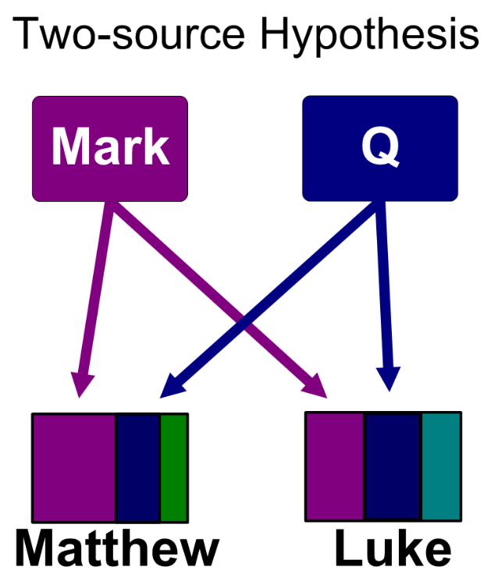
The Q Hypothesis

Slide 20
The Q Hypothesis
“Q” is
from
German:
Quelle
(Source)

Slide 21
The Q Hypothesis
…is closely related to “the Quest for the
Historical Jesus”.

Slide 22
Quest for the Historical Jesus

Slide 23
Quest for the Historical Jesus
Assumptions:

Slide 24
Quest for the Historical Jesus
Assumptions:
  Miracles are impossible

Slide 25
Quest for the Historical Jesus
Assumptions:
  Miracles are impossible
  Jesus never rose from the dead

Slide 26
Quest for the Historical Jesus
Assumptions:
  Miracles are impossible
  Jesus never rose from the dead
  Early Christians had no interest in…
Notes:
No interest in the actual words or life of Jesus.
Gospel was written to help shape the early church.
Tells us a lot about 2nd century church which invented these stories, but not much about jesus.
Why you even bother to care about the Gospels if you don’t believe the resurrection happened, I don’t know.

Slide 27
Quest for the Historical Jesus
If you assume you have zero eyewitness
accounts…

Slide 28
Quest for the Historical Jesus
If you assume you have zero eyewitness
accounts…
…people made stories up, with no actual
interest in history…

Slide 29
Quest for the Historical Jesus
Are there any fragments of genuine
knowledge here about who Jesus was and
what he was like?

Slide 30
Quest for the Historical Jesus
Are there any fragments of genuine
knowledge here about who Jesus was and
what he was like?
“The Jesus Seminar.”
Notes:
Voted with marbles.
Came up with a “historical Jesus” who was a travelling shaman. Had interesting proverbs and stories, but his only “miracles” were more akin to hypnosis and positive thinking.
There were no “nature miracles” (like the calming of the storm on Galilee) at all.
He was probably crucified, but he definitely never came back from the dead.
The quest for the historical Jesus is not the same as the Q hypothesis, but the two are strongly connected with each other

Slide 31
Problems with the Q Hypothesis
Notes:
I will go over these briefly, then go back to look at each in turn.

Slide 32
Problems with the Q Hypothesis
Assumption Mark written first.

Slide 33
Problems with the Q Hypothesis
Assumption Mark written first.
Hypothetical nature of Q.

Slide 34
Problems with the Q Hypothesis
Assumption Mark written first.
Hypothetical nature of Q.
Ignores witness of early Christians.

Slide 35
Problems with the Q Hypothesis
Assumption Mark written first.
Hypothetical nature of Q.
Ignores witness of early Christians.
Ignores archaeological evidence.

Slide 36
Problems with the Q Hypothesis
The unquestioned assumption at the
heart of Mark being first…
Notes:
19th century philosophical idea of the development from the simple to the complex, a la Darwin (whose ideas were like a bombshell in the broader culture).
The simple is smaller or shoreter. The more complex is larger or longer.
Thje idea that the grammatically improved texts of Matthew and Luke come after Mark is in accord with the nineteenth century theory of progress, according to which there is a tendency for things to get better, not worse; more sophisticated, not more simple.
Once you decide that Mark came first — deciding a priori to use Darwinian thinking as the guiding light in biblical interpretation — you de facto reject the unanimous reports of early Christian writers that Matthew came first, as well as internal literary evidence that Matthew came first. Hence, the compositional relationship between the Gospels becomes a “problem.”

Slide 37
Problems with the Q Hypothesis
2. The hypothetical nature of Q.
Notes:
11 different reconstructions of Q – with not a single verse of Matthew present in all of them.
No fragment of manuscript. Christians developed a passion, from day 1, for copying and distributing Scripture. If Q ever existed, it is quite odd that not a single page of it has ever turned up.
The reconstructfions of Q don’t look like a gospel.
They don't include an account of Jesus' death and resurrection. But from the earliest Christian writings, we see a strong emphasis on precisely the element that the hypothetical Q omits: Jesus' death and resurrection.
There is a difference between MISSING and HYPOTHETICAL. The BBC didn’t save its earliest episodes of Dr. Who—but we know from many sources that they existed.
There is not the first ancient HINT that Q ever existed. It exists only in the minds of 20th and 21st century writers.

Slide 38
Problems with the Q Hypothesis
3. External historical data.
Notes:
There is quite a lot of this.

Slide 39
Problems with the Q Hypothesis
3. External historical data.
Papias (A.D. 60-130)
Notes:
Papias lived in Ephesus, and got to hear stories told by the Apostle John. He was at the same distance to the life of Jesus as I am to World War 2, having heard my father’s eyewitness stories of events during WW2 in Europe.
He said that Mark was not an eyewitness to the life of Jesus…but wrote down Peter’s memories of his time with Jesus.

Slide 40
Problems with the Q Hypothesis
3. External historical data.
Papias (A.D. 60-130)
Irenaeus (A.D. 130-200)
Notes:
Born in Smyrna, and sat under the teaching of those who had heard John’s stories first hand.
Matthew came first, then Mark and Luke, and last of all John.

Slide 41
Problems with the Q Hypothesis
3. External historical data.
Papias (A.D. 60-130)
Irenaeus (A.D. 130-200)
Prologue to Old Latin Ver (ca. 150–200)
Notes:
Translations published in Italy.
Peter was asked to give some talks in Rome, and Mark recorded the talks. Peter authorized the broader publication of Mark’s transcript of his talks.
After Peter died, Mark left for Alexandria to plant a church there.
John’s gospel was produced last.

Slide 42
Problems with the Q Hypothesis
3. External historical data.
Papias (A.D. 60-130)
Irenaeus (A.D. 130-200)
Clement of Alexandria (ca. 150–215)
Prologue to Old Latin Ver (ca. 150–200)
Notes:
From Egypt.
Matthew and Luke composed first.
Peter gave talks in Rome to influential Christians, and to members of Caesar’s Praetorian Guard, and the believers there agitated for Mark to circulate the transcripts. Peter neither forbade nor promoted the broader publication of his talks.

Slide 43
Problems with the Q Hypothesis
3. External historical data.
Papias (A.D. 60-130)
Origen (A.D. 185–254)
Irenaeus (A.D. 130-200)
Clement of Alexandria (ca. 150–215)
Prologue to Old Latin Ver (ca. 150–200)
Notes:
Origen originally from Egypt, but relocated to Caesarea…and helped it to become a center of early Christian training.
There are four and only four gospels, the first written by the tax collector Matthew…who published it for the believers from Judaism.
Second, Mark. Then Luke—composed for those from the Gentiles—and finally John’s.

Slide 44
Problems with the Q Hypothesis
3. External historical data.
Papias (A.D. 60-130)
Origen (A.D. 185–254)
Eusebius (260-340)
Irenaeus (A.D. 130-200)
Clement of Alexandria (ca. 150–215)
Prologue to Old Latin Ver (ca. 150–200)
Notes:
Also from Caesarea, on the coast of Palestine.
Mark did not originally intend to circulate Peter’s talks. But there was such huge interest in the Christian community that he released it to be duplicated and circulated.
Mark was the first to be sent to plant a church in Egypt.

Slide 45
Problems with the Q Hypothesis
3. External historical data.
Papias (A.D. 60-130)
Origen (A.D. 185–254)
Eusebius (260-340)
Irenaeus (A.D. 130-200)
Augustine (c. 354–430)
Clement of Alexandria (ca. 150–215)
Prologue to Old Latin Ver (ca. 150–200)
Notes:
From North Africa – modern day Algeria.
Gospels were composed in this order: Matthew, Mark, Luke, John.
A broad consensus of writers from:
Italy
North Africa
Egypt
The Aegean basin dominated by Greece.
…with knowledge passed from master to disciple. If we are to take seriously ANY histsorical accounts from ancient times, e.g.
Life and deeds of Socrates, Alexander the Great, Julius Caesar
The invasion of Greece by the Persians at the Battle of Marathon and the pass as Thermopylae
The great fire of Rome during the reign of Nero
The sack of Rome by the Visigoths in 410
…then we must surely take into account this BROAD and DEEP external evidence as to the genesis of our four gospels.

Slide 46
Problems with the Q Hypothesis
4. Archaeological evidence.

Slide 47
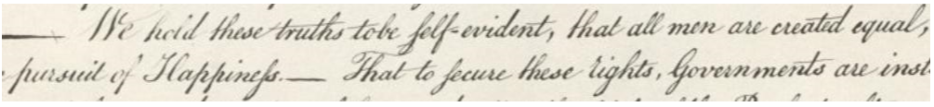
Problems with the Q Hypothesis
4. Archaeological evidence.
Notes:
Even without training, you can say that the first example is older than the second.
You can probably even come up with a date to the nearest century.

Slide 48
Problems with the Q Hypothesis
4. Archaeological evidence.
Notes:
The long S at the beginning or middle of a word…looks like a calligraphy version of “f”.

Slide 49
Problems with the Q Hypothesis
4. Archaeological evidence.
Notes:
Contrast in a single word.
The second is an example of a technical style of writing taught to engineers in the 20th century…for labelling blueprints.

Slide 50
Problems with the Q Hypothesis
4. Archaeological evidence.
“Long S” used in 1776…
Notes:
Declaration of Independence.

Slide 51
Problems with the Q Hypothesis
4. Archaeological evidence.
“Long S” used in 1776…disappeared by
1812.
Notes:
The US Declaration of War against Britain used only the short S.
You can find a cutoff date later around 1800.
Hard for us to imagine in the age of keyboards and emoji. But through history, literate people were taught that there was a RIGHT way and a WRONG way to write. The took the shape of alphabet characters very seriously.
PALEOGRAPHY has been confirmed as a valid archaeological technique for dating documents. Confirmed by carbon-14 dating, and other methods.

Slide 52
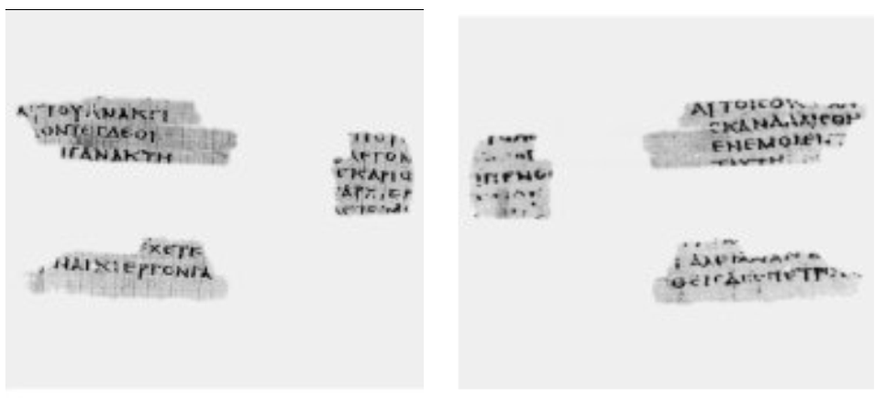
Problems with the Q Hypothesis
4. Archaeological evidence.
P64 — “The Magdalen Papyrus”
Notes:
Came from southern Egypt.

Slide 53
Problems with the Q Hypothesis
4. Archaeological evidence.
P64 — “The Magdalen Papyrus”
Bound as a book,
not a scroll.
Writing on both
Sides.

Slide 54
Problems with the Q Hypothesis
4. Archaeological evidence.
P64 — “The Magdalen Papyrus”
Bound as a book,
not a scroll.
Writing on both
sides.
Matthew 26
Verses 7-8,
10, 14-15,
22-23, 31,
and 32-33

Slide 55
Problems with the Q Hypothesis
4. Archaeological evidence.
P64 — “The Magdalen Papyrus”
Bound as a book,
not a scroll.
Writing on both
sides.
Matthew 26
Verses 7-8,
10, 14-15,
22-23, 31,
and 32-33
Dating: Pre-A.D. 66
Notes:
The study of papyrus documets is called “papyrology”. The study of handwriting is “paleography”. These are highly regarded disciplines, used not just in biblical studies, but very generally by non-Christian historians.
Indeed, some of the important papyrologists who have confirmed the pre-66 AD date of P64 are not Christians at all. They have no theological axe to grind.
Pretty impressive that a copy of Matthew made its way to southern Egypt—potentially very quickly.
The more we understand of Roman communications, the easier this is to imagine.
Rome had 80,500 km of paved roads.
320,000 km of secondary roads.
Network of couriers – a letter from Rome to Alexandria, Egypt, in just three days.
The Canadian Post Office does not offer this sort of efficiency today.

Slide 56
Problems with the Q Hypothesis
4. Archaeological evidence.
The Q Hypothesis
P64 — “The Magdalen Papyrus”
Bound as a book,
not a scroll.
Writing on both
sides.
Matthew 26
Verses 7-8,
10, 14-15,
22-23, 31,
and 32-33
Dating: Pre-A.D. 66
Notes:
For several different reasons, then, the Q hypothesis comes up short.

Slide 57
The MLMJ Hypothesis
Notes:
There are some pretty serious evangelical Christians who have proposed this—and it makes the very most sense to me.

Slide 58
The MLMJ Hypothesis
Matthew Luke Mark John

Slide 59

The MLMJ Hypothesis
Matthew Luke Mark John
Matthew Likes Mango Juice
Notes:
If you find this order hard to remember, you can remember this.

Slide 60
The MLMJ Hypothesis
Matthew Luke Mark John
Matthew Likes Mango Juice
Starts with an open mind, willing to go where the data leads it….
not with a 19th century, Darwinian presupposition about the
inevitability of progress.

Slide 61
The MLMJ Hypothesis
Matthew Luke Mark John
Matthew Likes Mango Juice
Starts with an open mind, willing to go where the data leads it….
not with a 19th century, Darwinian presupposition about the
inevitability of progress.
Very serious about internal, literary evidence of gospels.
Notes:
…the pattern of verses that are shared between Matthew and Luke, but not Mark.

Slide 62
The MLMJ Hypothesis
Matthew Luke Mark John
Matthew Likes Mango Juice
Starts with an open mind, willing to go where the data leads it….
not with a 19th century, Darwinian presupposition about the
inevitability of progress.
Very serious about internal, literary evidence of gospels.
Takes external, historical evidence of early believers seriously.

Slide 63
The MLMJ Hypothesis
Matthew Luke Mark John
Matthew Likes Mango Juice
Starts with an open mind, willing to go where the data leads it….
not with a 19th century, Darwinian presupposition about the
inevitability of progress.
Very serious about internal, literary evidence of gospels.
Takes external, historical evidence of early believers seriously.
Takes archaeological evidence seriously.

Slide 64
The MLMJ Hypothesis
Matthew
  Unanimous…
  History of Church growth
Notes:
In light of the history of the growth of the church (which started out in Jerusalem), this makes good sense.
While you can’t talk about Jesus without talking about the world-wide scope of the kingdom…

Slide 65
The MLMJ Hypothesis
Matthew
  Unanimous…
  History of Church growth
  His primary concerns
Notes:
Matt’s initial concern was to help new and potential believers who were Jewish understand that Jesus had fulfilled all the prophecies about the Messiah.
He unpacked things that would be especially meaningful to Jewish people.

Slide 66
The MLMJ Hypothesis
Matthew
  Unanimous…
  History of Church growth
  His primary concerns
Notes:
Jesus’ ancestry as a son of David.
His being born of a virgin.
His commendation by John the Baptist.
His miracles.
His teaching with authority in the Temple.
His coming to fulfill the Law of Moses.
His suffering like the Servant of Isaiah.
His rejection by his own nation.
His miraculous resurrection from the dead.

Slide 67
The MLMJ Hypothesis
Matthew
  Unanimous…
  History of Church growth
  His primary concerns
  Why Matthew?
Notes:
The Twelve entrusted this work to Matthew, not long after the resurrection.
As a former tax collector, his education and life experience probably made him the best choice write a work in Greek.
He made use of all five literary forms that were then considered the hallmark of good biographical writing in the Hellenistic world:
• The proverb
• The narrative
• The parable
• The anecdote (or short story)
• The reminiscence (or longer story)

Slide 68
The MLMJ Hypothesis
Matthew
  Unanimous…
  History of Church growth
  His primary concerns
  Why Matthew?
  Role in the church
Notes:
A scroll of Matthew was what each of the apostles carried under his arm as he left for his own distant field of evangelization.
It both supported and confirmed the preaching of the scattered Christians, as well as assuring a level of quality control/theological unity in their presentations about Jesus.
Paul almost surely took a scroll of Matthew with him on his own missionary journeys.
I am convinced he had Matthew 24 at his elbow as he wrote 1 Thessalonians 4-5.

Slide 69
The MLMJ Hypothesis
Luke
  When?
Notes:
Paul was detained by the Romans for more than two years at their headquarters in Caesarea.
The upside of this was that it provided Luke with sufficient time to check the details in Matthew’s account of the life of Jesus, to interview many of those who had known Jesus some 30 years previously (probably including Mary, the mother of Jesus), and to prepare a new gospel document closely modeled on Matthew’s.
Today we wonder why there is so much redundancy. Luke was INTENDED to contain redundancy. It was a revision and a tweaking of Matthew, with some new material added.

Slide 70
The MLMJ Hypothesis
Luke
  When?
  What?
Notes:
He omitted things which would have been of minimal interest to a Greek audience, such as:
• the relationship between Jesus and the Law of Moses, and
• Jesus as the fulfillment of Jewish prophecy.
He added material that was of interest to him, and which he thought would be of interest to his audience, such as:
• names, dates, and times
• a more extensive unpacking of the trans-cultural validity of Jesus as savior
• how Jesus connected to members of society who were despised by most people
• the critical role of prayer
• how Jesus related particularly to women.

Slide 71
The MLMJ Hypothesis
Luke vs. Matthew on divorce
Matthew 19
3 Some Pharisees came to him to test him. They asked, “Is it lawful for a man to divorce his wife for any and every reason?”
4 “Haven’t you read,” he replied, “that at the beginning the Creator ‘made them male and female,’[a] 5 and said, ‘For this reason a man will leave his father and mother and be united to his wife, and the two will become one flesh’[b]? 6 So they are no longer two, but one flesh. Therefore what God has joined together, let no one separate.”
7 “Why then,” they asked, “did Moses command that a man give his wife a certificate of divorce and send her away?”
8 Jesus replied, “Moses permitted you to divorce your wives because your hearts were hard. But it was not this way from the beginning. 9 I tell you that anyone who divorces his wife, except for sexual immorality, and marries another woman commits adultery.”
10 The disciples said to him, “If this is the situation between a husband and wife, it is better not to marry.”
11 Jesus replied, “Not everyone can accept this word, but only those to whom it has been given. 12 For there are eunuchs who were born that way, and there are eunuchs who have been made eunuchs by others—and there are those who choose to live like eunuchs for the sake of the kingdom of heaven. The one who can accept this should accept it.”
Notes:
This rabbinic-style Bible teaching was very familiar for Jews. 3 Some Pharisees came to him to test him. They asked, “Is it lawful for a man to divorce his wife for any and every reason?”
4 “Haven’t you read,” he replied, “that at the beginning the Creator ‘made them male and female,’[a] 5 and said, ‘For this reason a man will leave his father and mother and be united to his wife, and the two will become one flesh’[b]? 6 So they are no longer two, but one flesh. Therefore what God has joined together, let no one separate.”
7 “Why then,” they asked, “did Moses command that a man give his wife a certificate of divorce and send her away?”
8 Jesus replied, “Moses permitted you to divorce your wives because your hearts were hard. But it was not this way from the beginning. 9 I tell you that anyone who divorces his wife, except for sexual immorality, and marries another woman commits adultery.”
10 The disciples said to him, “If this is the situation between a husband and wife, it is better not to marry.”
11 Jesus replied, “Not everyone can accept this word, but only those to whom it has been given. 12 For there are eunuchs who were born that way, and there are eunuchs who have been made eunuchs by others—and there are those who choose to live like eunuchs for the sake of the kingdom of heaven. The one who can accept this should accept it.”

Slide 72
The MLMJ Hypothesis
Luke vs. Matthew on divorce
Luke 16
18 “Anyone who divorces his wife and marries another woman commits adultery, and the man who marries a divorced woman commits adultery.
Notes:
Luke simply went to the heart of what Jesus said, without reporting on the rabbinic-style presentation.

Slide 73
The MLMJ Hypothesis
Mark
Notes:
To recap: The Gospel of Matthew had been in circulation for 20 years or so throughout the Christian world, both inside and beyond the Roman Empire.
Paul arrived in Rome sometime in 61 or 62, accompanied by Luke, who brought with him the adaption of Matthew that he had compiled during Paul’s detention in Caesarea.

Slide 74
The MLMJ Hypothesis
Mark
  Recording Peter’s talks
Notes:
Unanimous view of early church that Peter was the “author” of Mark’s Gospel. Mark role was that of a editor and publisher.
Peter’s plan appears to have been to give a series of talks in Rome about “The Two Gospels”.
The prospect of these talks excited the interest of the most influential Christians in Rome, including members of the Praetorian Guard, an elite unit of the Roman army.
Partly, this was a PR exercise for the newly written Gospel of Luke.
He would talk about how Luke’s book dovetailed with his own, first-hand memories of Jesus, and to compare Luke’s treatment of events with Matthew’s accounts where he himself had been a participant.

Slide 75
The MLMJ Hypothesis
Mark
  Recording Peter’s talks
Notes:
Unanimous view of early church that Peter was the “author” of Mark’s Gospel. Mark role was that of a editor and publisher.
Peter’s plan appears to have been to give a series of talks in Rome about “The Two Gospels”.
The prospect of these talks excited the interest of the most influential Christians in Rome, including members of the Praetorian Guard, an elite unit of the Roman army.
Partly, this was a PR exercise for the newly written Gospel of Luke.
He would talk about how Luke’s book dovetailed with his own, first-hand memories of Jesus, and to compare Luke’s treatment of events with Matthew’s accounts where he himself had been a participant.

Slide 76
The MLMJ Hypothesis
Mark
  Recording Peter’s talks
  Common practice for 100 years
Notes:
Since Cicero, public speakers would arrange for people skilled in shorthand to record their speeches.
Mark arranged for people to write down Peter’s words as he spoke them.

Slide 77
The MLMJ Hypothesis
Mark
  Recording Peter’s talks
  Common practice for 100 years
  Nature of Peter’s talks
Notes:
It looks as though Peter arrived on location armed with a scroll of Matthew , as well as a scroll prepared by Luke, and gave five talks, from 25 to 40 minutes each.
These sections would fit nicely into a series of talks.
1. Beginning of ministry. Mark 1:2 to 3:19.
2. Early Galilean ministry. Mark 3:20 to 6:13.
3. Later Galilean ministry. Mark 6:14 to 10:1.
4. Post-Galilean ministry. Mark 10:2 to 13:37.
5. Passion narrative. Mark 14:1 to 16:8.

Slide 78
The MLMJ Hypothesis
Mark
Notes:
Peter spoke, checking with each gospel as he went along, starting with Matthew’s scroll, and then flipping into Luke’s scroll, and then back to Matthew’s, zig-zag fashion.
He never goes backward in either scroll.
In fact, it is difficult to account for this zig-zag use of scrolls except with a scenario similar to this.

Slide 79
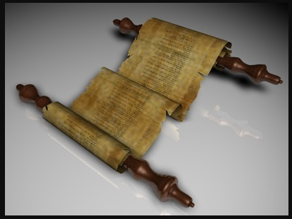
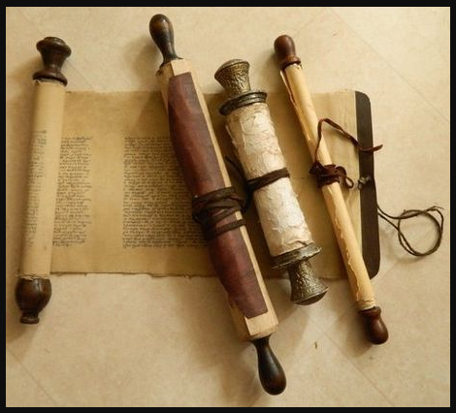
The MLMJ Hypothesis
Mark
Notes:
Presumably he went through both scrolls in advance and marked what the was going to include, what he would omit, and the exact point where he was going to switch from one scroll to the other.
Peter’s talks were striking for the way he added in vivid details that reveal him to be an eyewitness, such as Jesus’ being asleep on the cushion in the stern of the boat (Mark 4:38).

Slide 80
The MLMJ Hypothesis
Mark

Slide 81
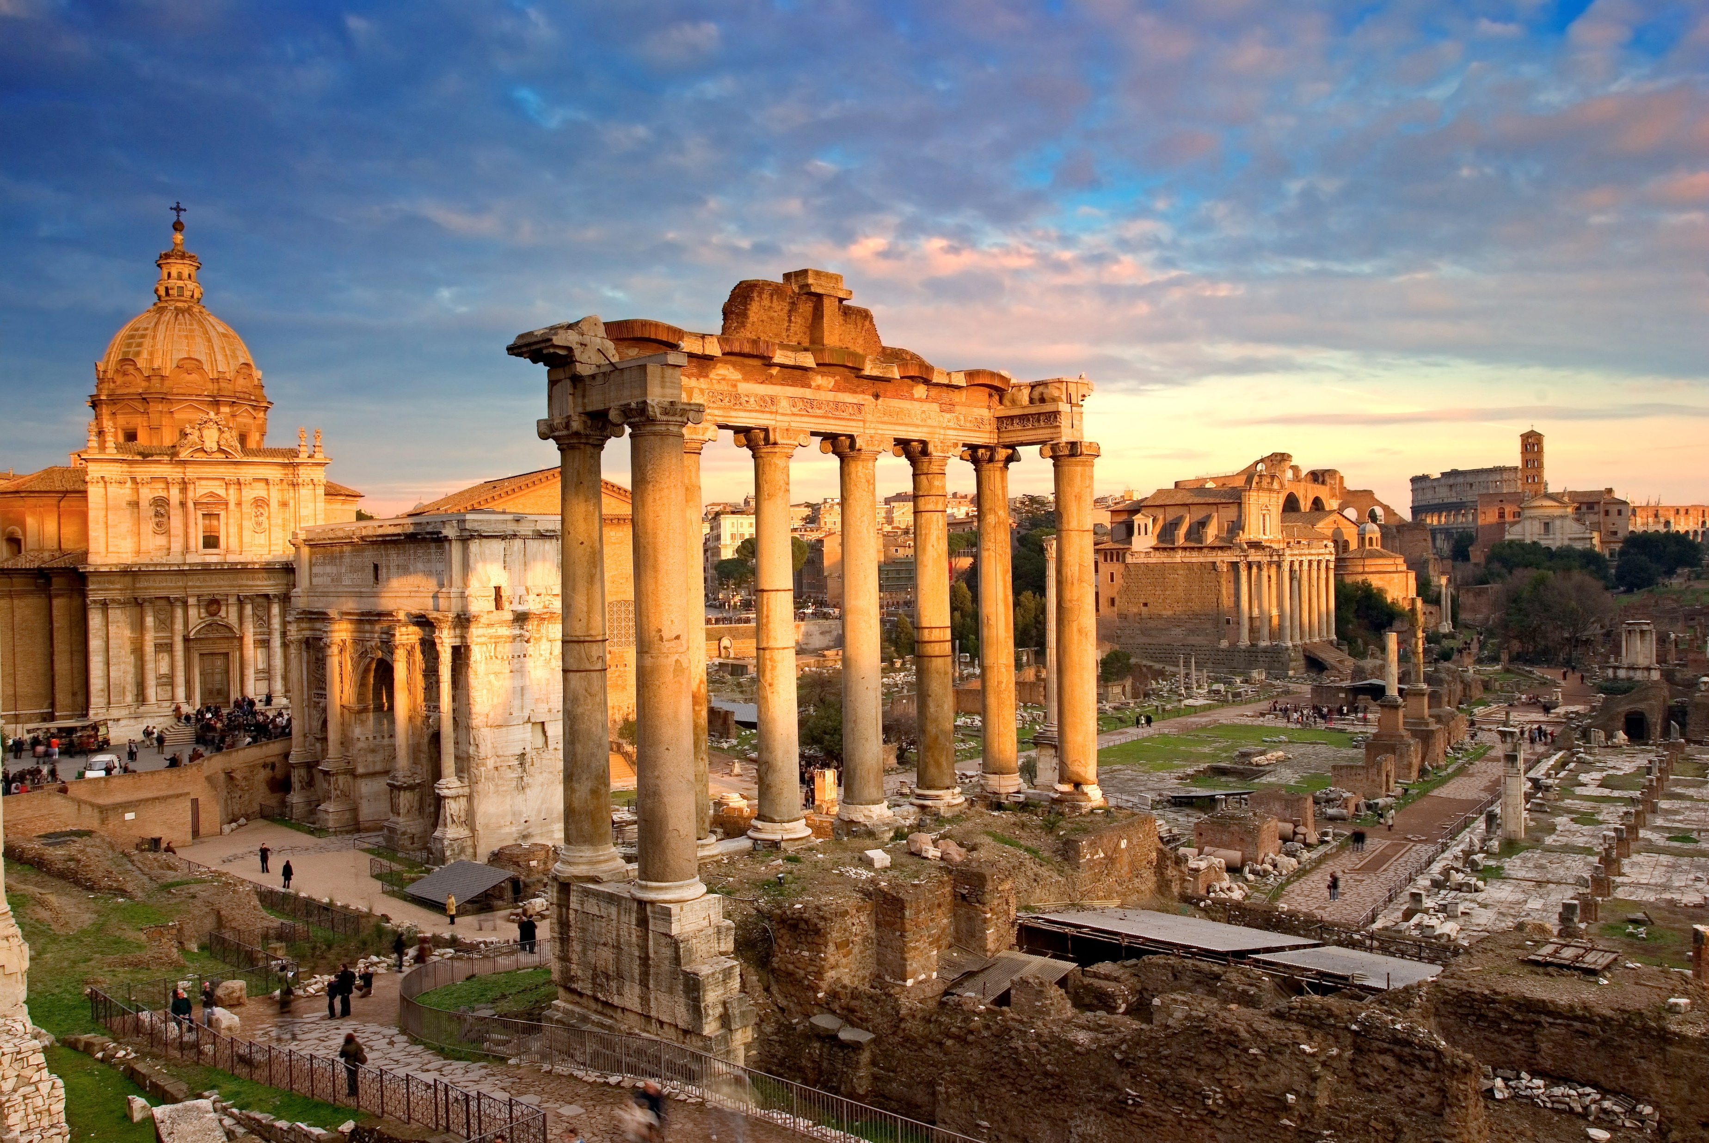
The MLMJ Hypothesis
Mark
Notes:
Those who listened to Peter were delighted, and asked Mark for copies of Peter’s talks.
Peter saw no particular advantage to circulating his talks, since Matthew (for the last 20+ years) and Luke (as of very recently) were already in circulation.
Though he probably never intended his talks to become a third Gospel, he did not forbid the making of copies.
And indeed, even though Peter’s memories of his times with Jesus were highly prized in the church, they did not enjoy the kind of circulation that Matthew and Luke did.
The Gospel of Mark was rarely quoted by early Christians, and the first commentary on it was not composed until the 5th century.
The fact that the style of Mark’s Gospel is vivid, colloquial and non-literary does not indicate that it was written first, but only that it is a transcript of a live speech.
Mark (the man) was not the author of the Gospel bearing his name, but the publisher of it.

Slide 82
The MLMJ Hypothesis
John
Notes:
After John, the last one still living from among the original 12 apostles, was released from exile on the island of Patmos (whence he wrote Revelation) and returned to Ephesus, younger Christians bugged him to capture some of his great stories about Jesus on paper.
I have said that this gospel was composed after John returned from Patmos. But actually, the gospel could have been composed either before or after his exile on Patmos…but was surely after he had left Palestine and arrived in Ephesus.

Slide 83
The MLMJ Hypothesis
John
  Author of both the gospel & Revelation
  Language is quite different.
Notes:
It is clear to me that he had help writing the Gospel.

Slide 84
The MLMJ Hypothesis
John
  Author of both the gospel & Revelation
  Language is quite different.
    In Rev. 1:4, John uses ἀπὸ followed, improperly, by a nominative case in ἀπὸ ὁ ὢν καὶ ὁ ἦν καὶ ὁ ἐρχόμενος (from the one who is, who was, and who is to come).

Slide 85
The MLMJ Hypothesis
John
    In the very next phrase, John uses ἀπὸ correctly, followed by a genitive case καὶ ἀπὸ τῶν ἑπτὰ πνευμάτων (and from the seven spirits).

Slide 86
The MLMJ Hypothesis
John
    In 17:4, John has a genitive and an accusative joined by καὶ rather than by two genitives.

Slide 87
The MLMJ Hypothesis
John
    In 17:4, John has a genitive and an accusative joined by καὶ rather than by two genitives.
    In 14:19, John uses a masculine adjective “the great” τὸν μέγαν to modify the feminine noun “winepress” τὴν ληνὸν.

Slide 88
The MLMJ Hypothesis
John
    In 4:1 he has ἡ φωνὴ ἡ πρώτη, a feminine (“the first voice”), taking a masculine participle λέγων (“spoke”).

Slide 89
The MLMJ Hypothesis
John
    In 4:1 he has ἡ φωνὴ ἡ πρώτη, a feminine (“the first voice”), taking a masculine participle λέγων (“spoke”).
    Etc.
    But in John, there is none of this.
Notes:
This tells me that John had help.
It could have been either before or after his exile to Patmos, but definitely after he left Israel and moved to Ephesus, where there were plenty of young, Greek Christians to help him.

Slide 90
The MLMJ Hypothesis
John
Similar to the role that
John & Elizabeth
Sherrill played in helping
other authors tell their
stories.

Slide 91
The MLMJ Hypothesis
John
Similar to the role that
John & Elizabeth
Sherrill played in helping
other authors tell their
stories.
Notes:
According to Christianity Today magazine, “John and Elizabeth Sherrill may be the most influential Christian authors you know nothing about.”

Slide 92
The MLMJ Hypothesis
John
Similar to the role that
John & Elizabeth
Sherrill played in helping
other authors tell their
stories.
Notes:
John died several years ago, but Elizabeth just died last year.

Slide 93
The MLMJ Hypothesis
John
Similar to the role that
John & Elizabeth
Sherrill played in helping
other authors tell their
stories.
Notes:
Elizabeth was hugely gifted “in coaxing stories out of others and then helping them share their highly personal accounts of God at work in their lives.”

Slide 94

The MLMJ Hypothesis
John
Similar to the role that
John & Elizabeth
Sherrill played in helping
other authors tell their
stories.
Notes:
John’s stories of Jesus are not unlike my father’s stories of flying a transport plane for the US Army in WW2.
Captivating eye-witness accounts.
Give you the feeling of being there.
Definitely not chronological.
Flying into a British airfield in Athens where the risk of attack was so great, Dad and his crew slept under a wing, so they could fly out at night immediately if need be.
Then to a story of his basic training in Miami Beach, FL.
Then to a post-war story of flying the first commercial flight from Cairo to Rome.
Back into the war period where he gave a blonde nurse the chance to fly with some medical supplies out of Rome.
John 2: wedding at Cana – the first miracle.
John 4: I know the Messiah will come. “I am him!” Probably from his final trip to Jerusalem, just before his crucifixion.
Then back to feeding the 5,000 in John 6.
Luke much more interested in laying out a chronological account.
Both have eyewitness accounts…but John’s is organized very differently. The memories of an old man.

Slide 95
The MLMJ Hypothesis
Takes into account…
  The external, historical evidence that Matthew was written first, and John last.
Notes:
Easy to see why Mark the early church put Mark in between Matthew and Luke. It is a connecting link between them.
The middle position has nothing to do with the chronological order in which the gospels were written, but with Mark’s role.
Also accounts for the slight ambivalence of the external historical evidence for the order in which the Gospels were written. Matthew is universally agreed to have been first, and John last.
Mark and Luke composed very close to each other. Luke written first, but Mark was more widely circulated initially.

Slide 96
The MLMJ Hypothesis
Takes into account…
  The external, historical evidence regarding the authorship of the various gospels.
Notes:
Matthew wrote Matthew. Luke wrote Luke. Mark and John wrote their respective gospels.

Slide 97
The MLMJ Hypothesis
Takes into account…
  The forensic evidence of papyrology that Matthew was circulated around the Empire prior to A.D. 66.
Notes:
Matthew wrote Matthew. Luke wrote Luke. Mark and John wrote their respective gospels.

Slide 98
The MLMJ Hypothesis
Takes into account…
  The internal, literary evidence that both Luke and Paul used Matthew.
  (www.NTGreek.ca/Q)
Notes:
Download an essay of this presentation at www.NTGreek.ca/Q – my translation notes from 1 Thess 4 & 5.

Slide 99
The MLMJ Hypothesis
Takes into account…
  The internal, literary evidence that the Gospel of Matthew would have served Paul’s missionary needs…but only imperfectly.
Notes:
It included a lot of information that was highly relevant in Jewish evangelism, but largely irrelevant in Greek evangelism. Paul needed more suitable tool

Slide 100
The MLMJ Hypothesis
Takes into account…
  The external, historical evidence that Mark compiled his gospel from a series of talks that Peter gave in Rome to members of the Praetorian Guard and others.
Notes:
That Mark was never composed as a literary work, but were speaking notes from an influential series of talks that Peter gave in Rome.

Slide 101
The MLMJ Hypothesis
Takes into account…
  The curious fact that we have three gospels to begin with which are so very similar in content.
Notes:
How on earth did they come to be, and why?

Slide 102
The MLMJ Hypothesis
Takes into account…
  The even more curious zig-zag fashion in which pericopes in Mark move forward through parallel passages in Matthew and Luke.
Notes:
The even more curious, and otherwise inexplicable, zig-zag fashion in which pericopes in Mark move forward — always forward and never back — through parallel passages in Matthew and Luke.

Slide 103
Why Four Gospels?
Why Four Gospels?
www.NTGreek.ca/Q
Notes:
A bit more complete than this PowerPoint.
Includes my translation notes from 1 Thess 4 & 5, which convinces me that Paul carried a copy of Matthew’s scroll with him on all of his missionary journeys.
Questions?

